Slide 1
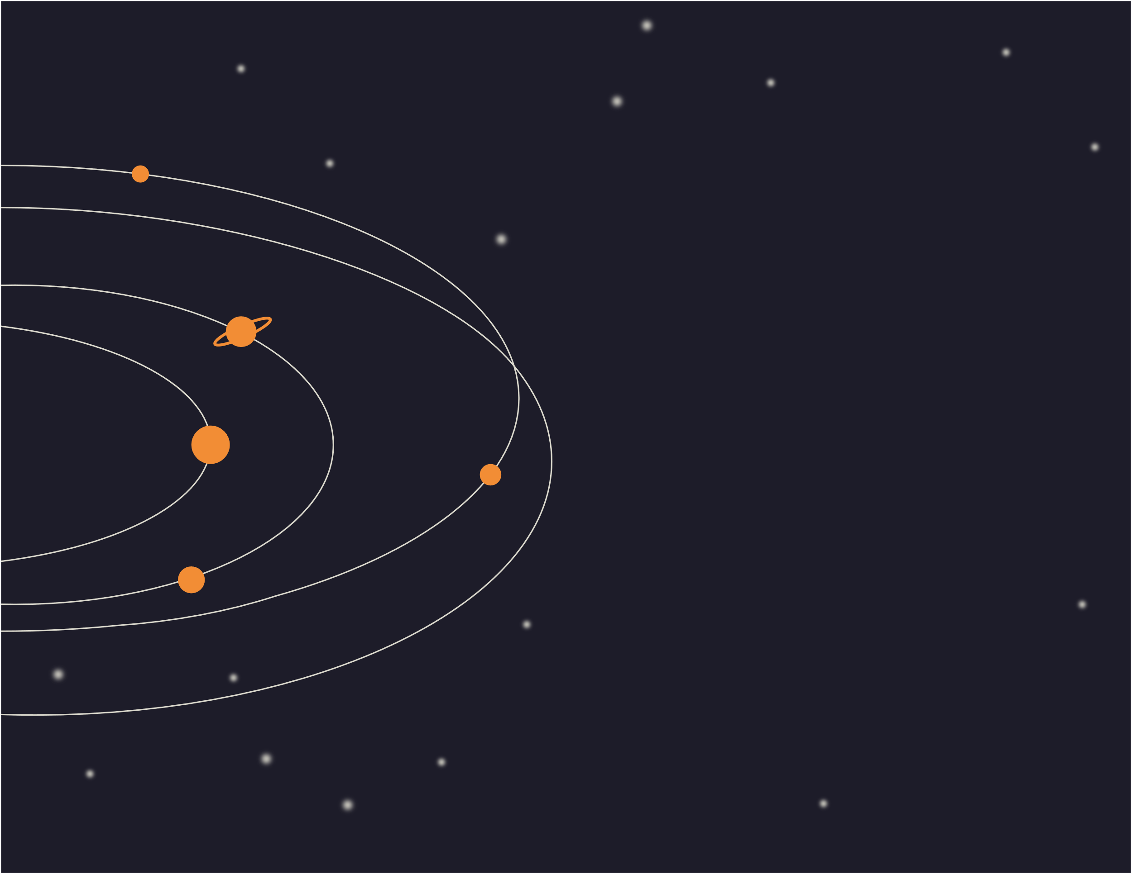
August Bergqvist
Astronomy Club Certificate
Bellows Elementary congratulates
for successfully observing the moon and stars like a real astronaut. You're out of this world!
Juan Morgan , Principal
January 20, 20XX
Date

Slide 2

August Bergqvist
Science Star Certificate
Bellows Elementary congratulates
for successfully participating in the school science fair. You're mole-cool!
January 20, 20XX
Juan Morgan, Principal
Date

Slide 3

August Bergqvist
Certificate of Achievement
Bellows Elementary congratulates
for being an A+ student and having a positive attitude all year long! Good job!
January 20, 20XX
Juan Morgan, Principal
Date

